Slide 1

Deep Learning
Session 3
The Perceptron
Applied Data Science
2024/2025

Slide 2
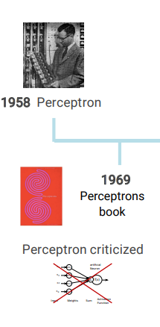
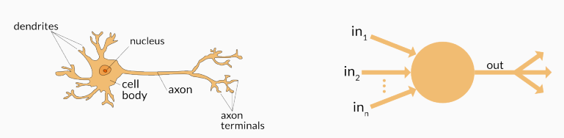
Perceptron
The Perceptron
Session 3

Slide 3
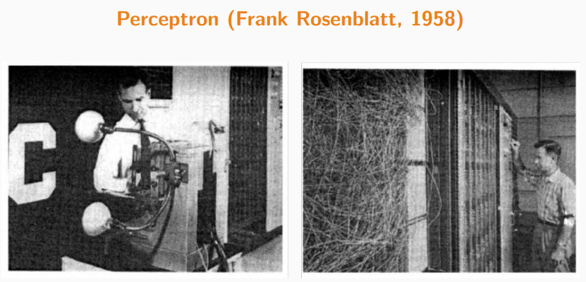
Perceptron
First binary classifier based on supervised learning;
Foundation of modern artificial neural networks;
The Perceptron
Session 3

Slide 4
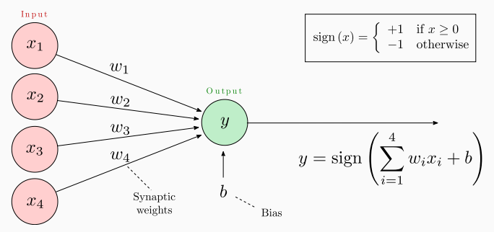
Representation of the Perceptron
Parameters of the perceptron:
w_{k}: weights
b: bias
Training → adjusting the weights and bias.
Activation function
The Perceptron
Session 3

Slide 5
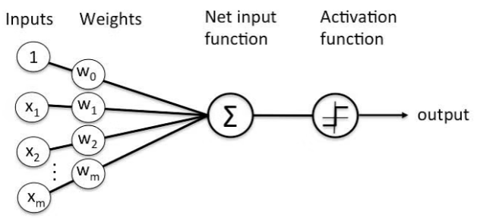
Alternative Representation of the Perceptron
The Perceptron
Session 3

Slide 6
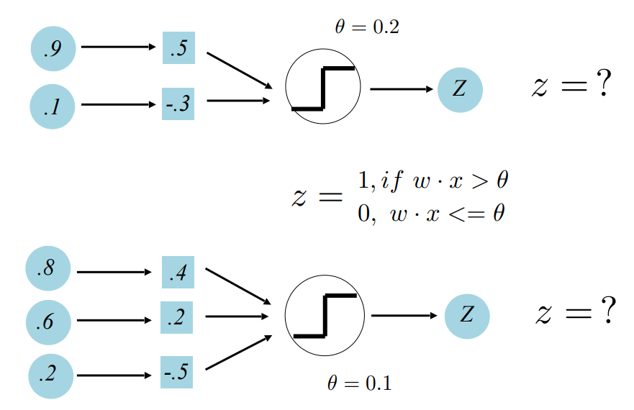
Perceptron Examples
The Perceptron
Session 3

Slide 7
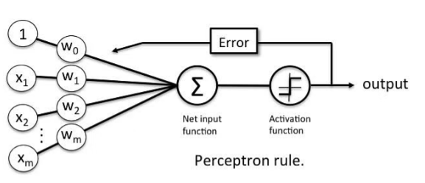
Perceptron Learning Rule
Suppose that x is a feature vector, y is the correct class label, and y' is the predicted class label computed using the current weights.
If y' = y, do nothing
Otherwise w_{i}^{new} = w_{i}^{old} + Δw_{i}^{old} , Δw_{i} = α (t - o)x_{i}
perceptron prediction
learning rate
real target value
The Perceptron
Session 3

Slide 8
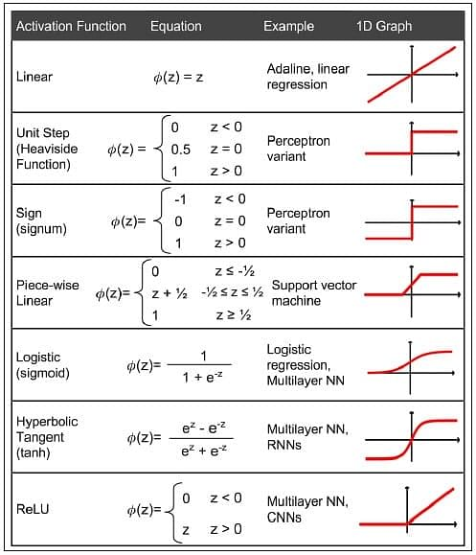
Activation Functions
The purpose of activation functions is to introduce non-linearities into the network.
The Perceptron
Session 3

Slide 9
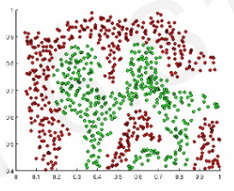
Activation Functions
The purpose of activation functions is to introduce non-linearities into the network.
What if we wanted to build a neural network to distinguish green vs red points?
The Perceptron
Session 3

Slide 10
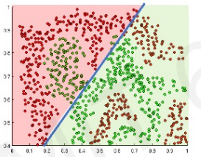
Activation Functions
The purpose of activation functions is to introduce non-linearities into the network.
Linear activations produce linear decisions no matter the network size.
The Perceptron
Session 3

Slide 11
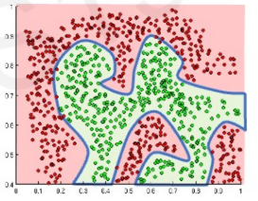
Activation Functions
The purpose of activation functions is to introduce non-linearities into the network.
Linear activations produce linear decisions no matter the network size.
Non-linearities allow us to approximate arbitrarly complex functions.
The Perceptron
Session 3

Slide 12
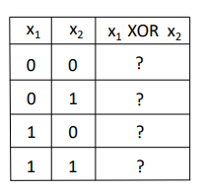
Perceptron Limitation: XOR Problem
XOR = "Exclusive Or"
Input: two binary values x₁ and x₂
Output:
1, when exactly one input equals 1
0, otherwise
The Perceptron
Session 3

Slide 13
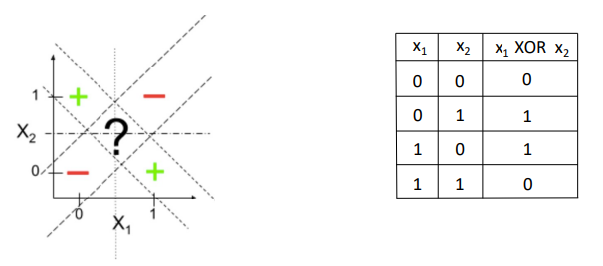
Perceptron Limitation: XOR Problem
Cannot solve XOR problem and so separate 1s from 0s with a perceptron (linear function):
The Perceptron
Session 3

Slide 14
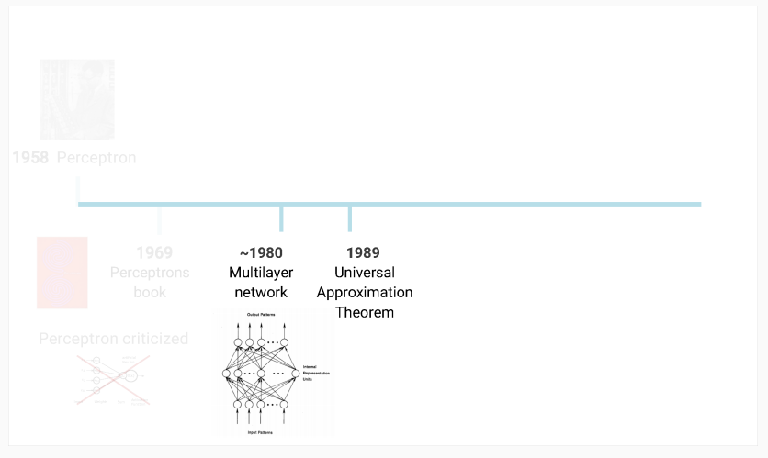
Multilayer Perceptron
The Perceptron
Session 3

Slide 15
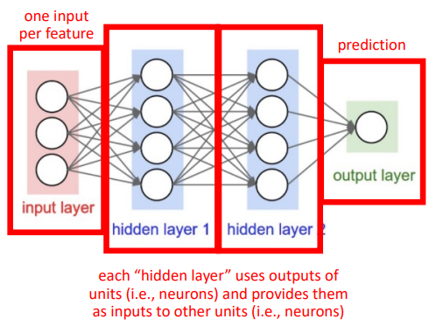
Mulilayer Perceptron
AKA Artificial Neural Networks
The Perceptron
Session 3

Slide 16
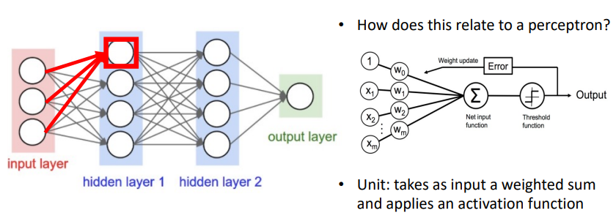
Mulilayer Perceptron
The Perceptron
Session 3

Slide 17
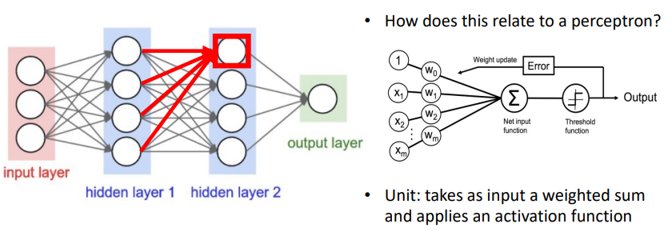
Mulilayer Perceptron
The Perceptron
Session 3

Slide 18
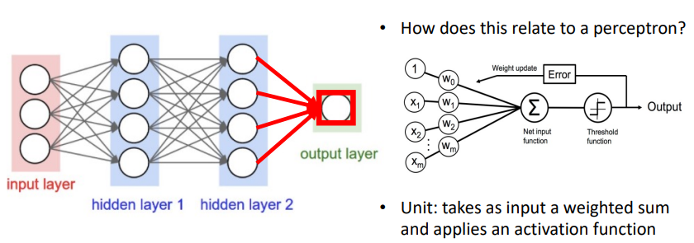
Mulilayer Perceptron
The Perceptron
Session 3

Slide 19
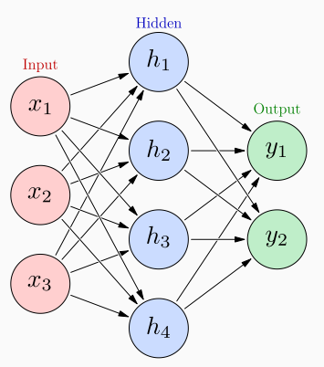
Artificial Neural Networks
Inter-connection of several artificial neurons (also called nodes or units);
Each "level" in the graph is called a lauer:
Input layer;
Hidden layer(s);
Output layer.
Each neuron in the hidden layers acts as a classifier / feature detector;
Fedforward neural network (no cycles):
First na simplest type of neural network;
Information moves in one direction.
The Perceptron
Session 3

Slide 20
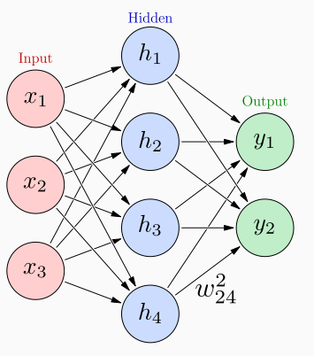
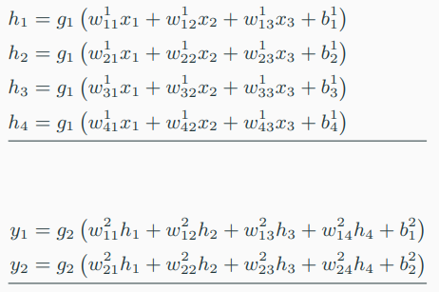
Artificial Neural Networks
w^{k}_{ij} weight between previous node j and next node i at layer k;
g_{k} is any activation function applied to each its input vector
The Perceptron
Session 3

Slide 21
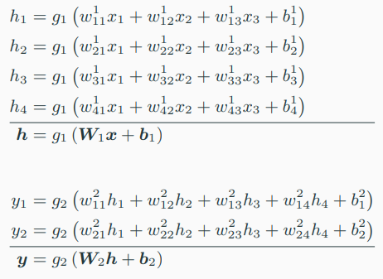
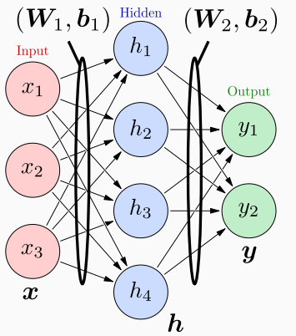
Artificial Neural Networks
The matrices W_{k} and biases b_{k} are learned from labeled training data.
The Perceptron
Session 3

Slide 22
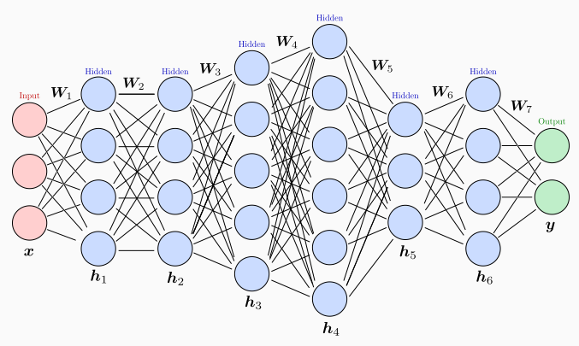
Artificial Neural Networks
It can have 1 hidden layer only (shallow network);
It can have more than 1 hidden layer (deep network);
Each layer can have a different size, and hidden and output layers often have different activation functions.
The Perceptron
Session 3

Slide 23
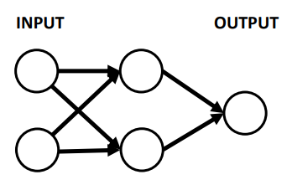
Revisiting the XOR Problem
Non-linear function: separate 1s from 0s
The Perceptron
Session 3

Slide 24

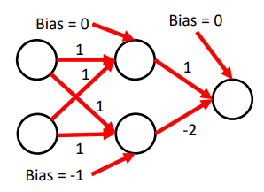
Revisiting the XOR Problem
Non-linear function: separate 1s from 0s
Approach: use the ReLU activation function
The Perceptron
Session 3

Slide 25
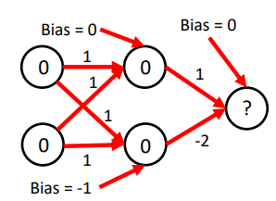
Revisiting the XOR Problem
Non-linear function: separate 1s from 0s
Approach: use the ReLU activation function
The Perceptron
Session 3

Slide 26
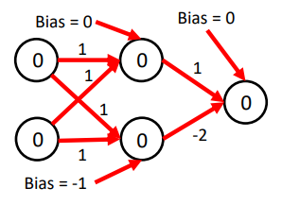
Revisiting the XOR Problem
Non-linear function: separate 1s from 0s
Approach: use the ReLU activation function
The Perceptron
Session 3

Slide 27
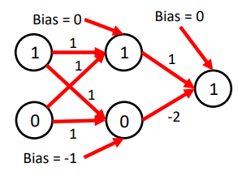
Revisiting the XOR Problem
Non-linear function: separate 1s from 0s
Neural networks can solve the XOR problem!
And so model non-linear functions!
The Perceptron
Session 3

Slide 28
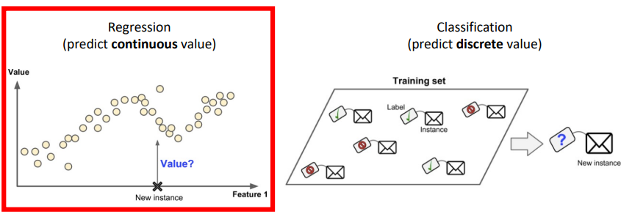
Output Activations
Desired output driven by task
The Perceptron
Session 3

Slide 29
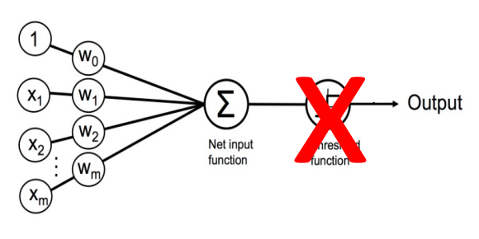
Output Activations
Linear (No Activation Function)
The Perceptron
Session 3

Slide 30
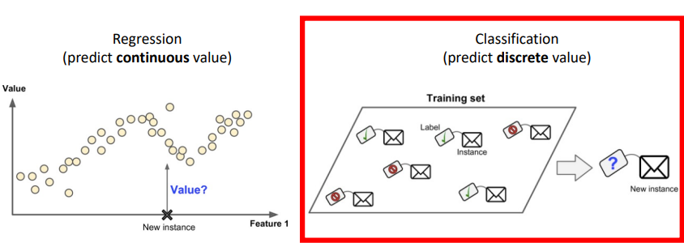
Output Activations
Desired output driven by task
The Perceptron
Session 3

Slide 31
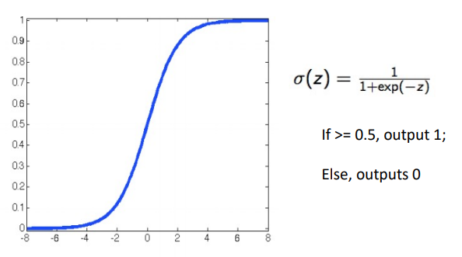
Output Activations
Sigmoid for Binary Classification
The Perceptron
Session 3

Slide 32
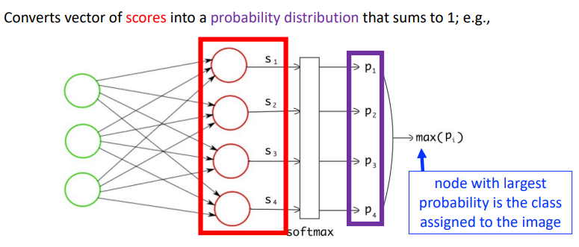
Output Activations
Softmax for Multiclass Classification
The Perceptron
Session 3

Slide 33
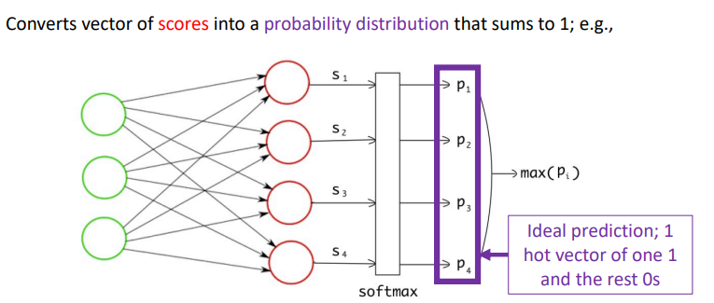
Output Activations
Softmax for Multiclass Classification
The Perceptron
Session 3

Slide 34
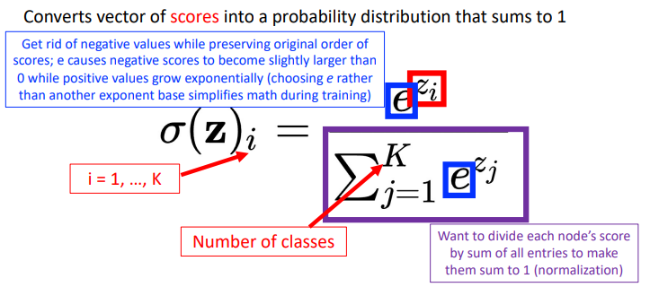
Output Activations
Softmax for Multiclass Classification
The Perceptron
Session 3

Slide 35
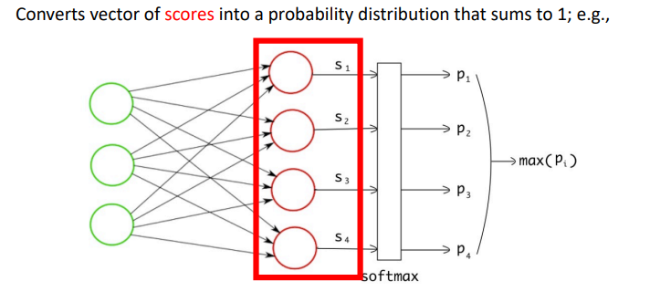
Output Activations
Softmax for Multiclass Classification
The Perceptron
Session 3

Slide 36
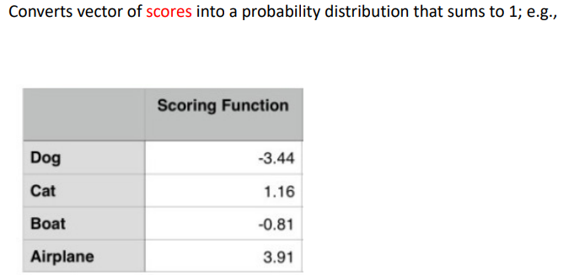
Output Activations
Softmax for Multiclass Classification
The Perceptron
Session 3

Slide 37
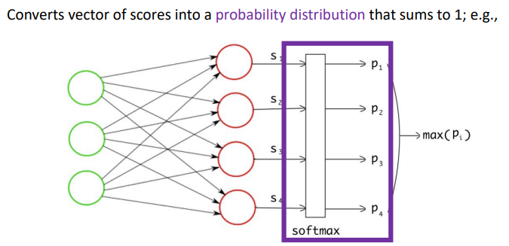
Output Activations
Softmax for Multiclass Classification
The Perceptron
Session 3

Slide 38
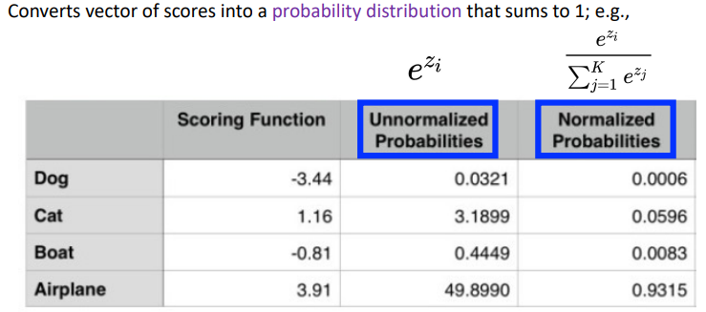
Output Activations
Softmax for Multiclass Classification
The Perceptron
Session 3

Slide 39
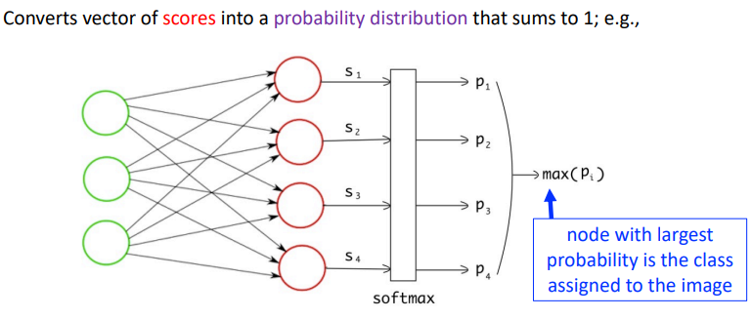
Output Activations
Softmax for Multiclass Classification
The Perceptron
Session 3

Slide 40
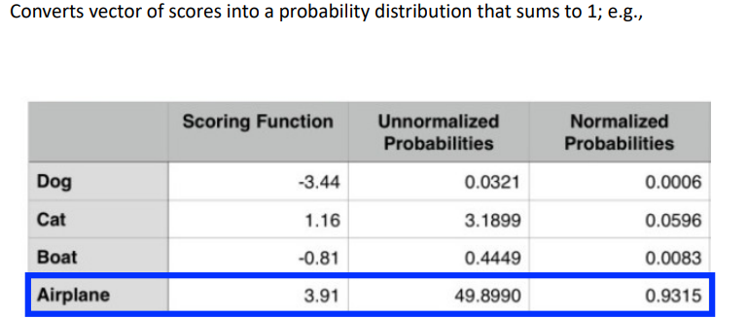
Output Activations
Softmax for Multiclass Classification
The Perceptron
Session 3

Slide 41
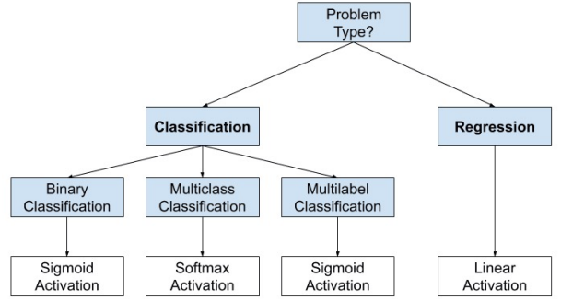
Output Activations
The Perceptron
Session 3

Slide 42
Example Problem
Will I pass this class?
Let's start with a simple two feature model
x₁ = Numbers of lectures you attend
x₂ = Hours spent on the final project
The Perceptron
Session 3

Slide 43
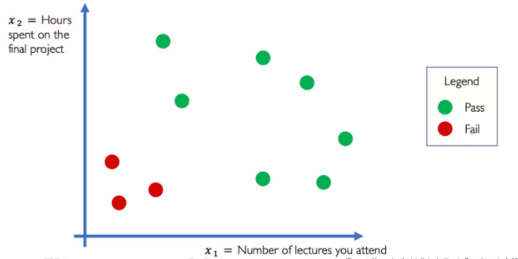
Example Problem: Will I pass this class?
The Perceptron
Session 3

Slide 44
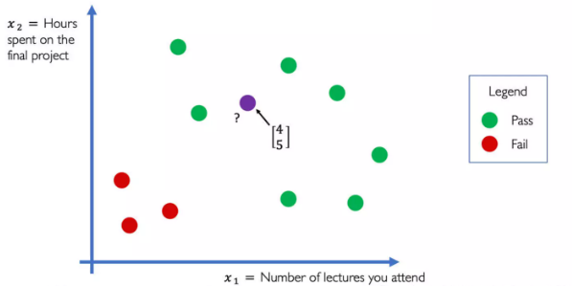
Example Problem: Will I pass this class?
The Perceptron
Session 3

Slide 45
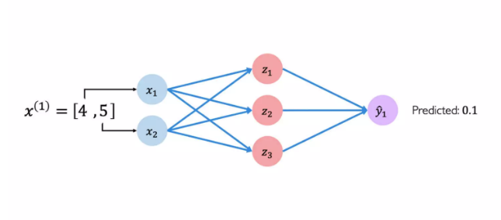
Example Problem: Will I pass this class?
The Perceptron
Session 3

Slide 46
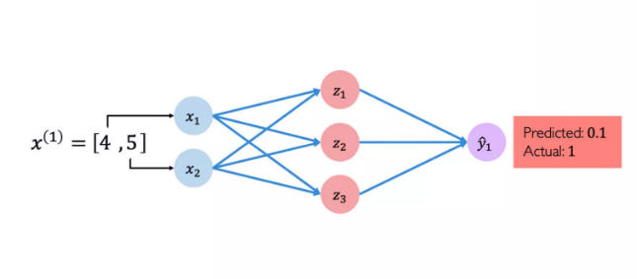
Example Problem: Will I pass this class?
The Perceptron
Session 3

Slide 47
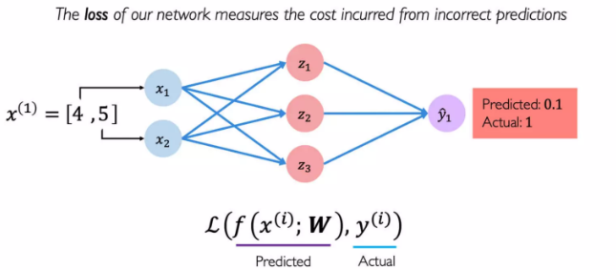
Quantifying Loss
The Perceptron
Session 3

Slide 48
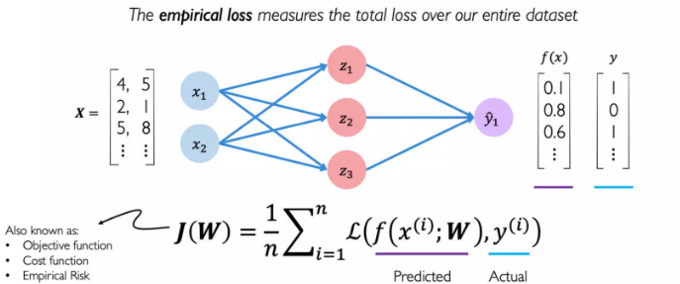
Empirical Loss
The Perceptron
Session 3

Slide 49
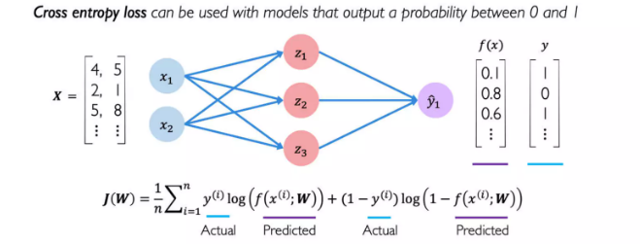
Binary Cross Entropy Loss
The Perceptron
Session 3

Slide 50

Mean Squared Error Loss
The Perceptron
Session 3

Slide 51
The Perceptron from Scratch
Let's implement the perceptron architecture from scratch using only numpy.
Use the perceptron.py script as a starting point.
The Perceptron
Session 3

